Slide 1
Regression Analysis
Poisson Regression
Nicoleta Serban, Ph.D.
Professor
Stewart School of Industrial and Systems Engineering
Model Description and Estimation

Slide 2

About This Lesson

Slide 3
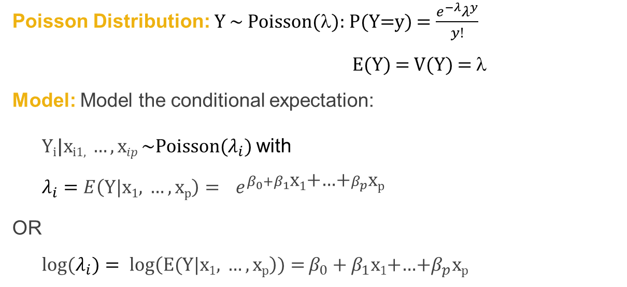
Poisson Regression Model
Data: {(x₁₁,.., x_{1p}),Y₁},….,{(x_{n1},.., x_{np} ),Y_{n}} where Y₁, .., Y_{n} are event count data per observation unit with a Poisson distribution
Poisson Distribution: Y ~ Poisson(λ): P(Y=y) = $\frac{e^{−λ}λ^{y}}{y!}$
E(Y) = V(Y) = λ
Model: Model the conditional expectation:
Y_{i}|$\text{x}\text{i}\text{1, }…,\text{x}ip$~Poisson($λ_{i}$) with
$$λ_{i}=E\left(Y|\text{x}\text{1}\text{, }…,\text{x}\text{p}\right){=} e^{β_{0}+β_{1}\text{x}\text{1}\text{+…+}β_{p}\text{x}\text{p} }$$
OR
log(${λ_{i})= log\left(E(Y|\text{x}\text{1}\text{,} …,\text{x}\text{p}\right)){=}β}_{0}+β_{1}\text{x}\text{1}$+…+$β_{p}\text{x}\text{p}$

Slide 4
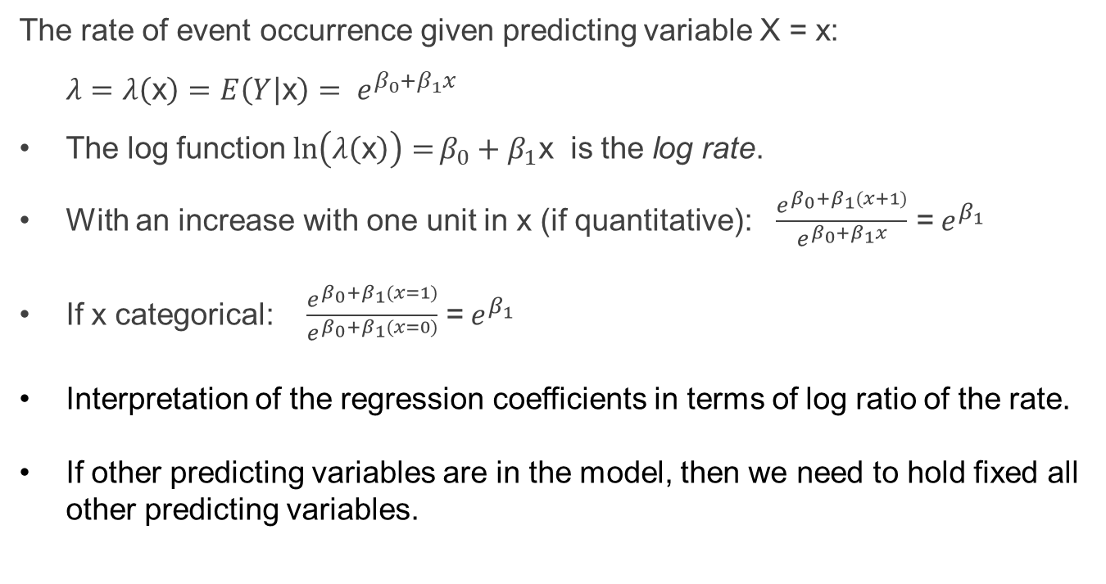
Model Interpretation
The rate of event occurrence given predicting variable X = x:
$λ=λ\left(\text{x}\right)=E\left(Y | \text{x}\right)= e^{β_{0}+β_{1}x}$
The log function ${\ln\left(λ\left(\text{x}\right)\right){=}β}_{0}+β_{1}\text{x}$ is the log rate.
With an increase with one unit in x (if quantitative): $\frac{e^{β_{0}+β_{1}(x+1)}}{e^{β_{0}+β_{1}x}}$ =$e^{β_{1}}$
If x categorical: $\frac{e^{β_{0}+β_{1}(x=1)}}{e^{β_{0}+β_{1}(x=0)}}$ =$e^{β_{1}}$
Interpretation of the regression coefficients in terms of log ratio of the rate.
If other predicting variables are in the model, then we need to hold fixed all other predicting variables.

Slide 5
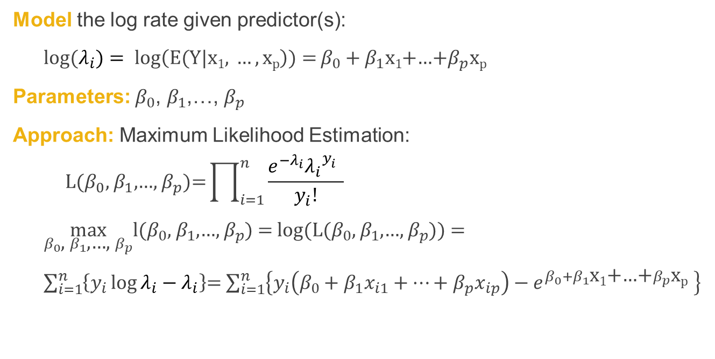
Model Estimation
Model the log rate given predictor(s):
log(${λ_{i})= log\left(E(Y|\text{x}\text{1}\text{, }…,\text{x}\text{p}\right)){=}β}_{0}+β_{1}\text{x}\text{1}$+…+$β_{p}\text{x}\text{p}$
Parameters: $β_{0}$, $β_{1}$,…, $β_{p}$
Approach: Maximum Likelihood Estimation:
$${\text{L}\text{(}β_{0}\text{, }β_{1}\text{,…, }β_{p}\text{)=}\prod_{i=1}^{n}{\frac{e^{−λ_{i}}{λ_{i}}^{y_{i}^{}}}{y_{i}!}}}$$
$\max_{β_{0}\text{, }β_{1}\text{,…, }β_{p}}$l($β_{0}$, $β_{1}$,…, $β_{p}$) = log(L($β_{0}$, $β_{1}$,…, $β_{p}$)) =
$\sum_{i=1}^{n}{\left\{y_{i}\log{λ_{i}}−λ_{i}\right\}}$= $\sum_{i=1}^{n}{\left\{y_{i}\left(β_{0}+β_{1}x_{i1}+…+β_{p}x_{ip}\right)−e^{β_{0}+β_{1}\text{x}\text{1}\text{+…+}β_{p}\text{x}\text{p} }\right\}}$

Slide 6
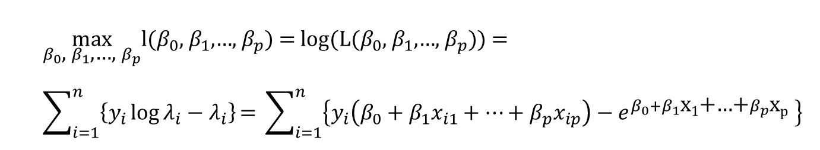
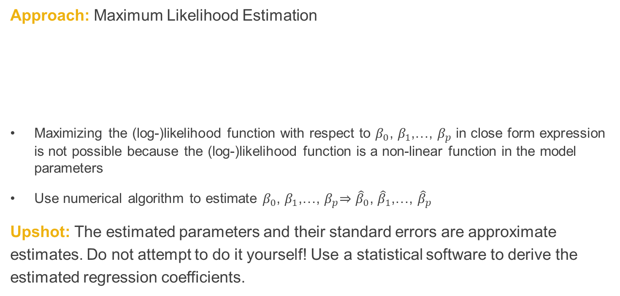
Model Estimation (cont’d)
Approach: Maximum Likelihood Estimation
Maximizing the (log-)likelihood function with respect to $β_{0}\text{, }β_{1}\text{,…, }β_{p}$ in close form expression is not possible because the (log-)likelihood function is a non-linear function in the model parameters
Use numerical algorithm to estimate $β_{0}\text{, }β_{1}\text{,…, }β_{p}$⇒ ${\hat{β}}_{0}\text{, }{\hat{β}}_{1}\text{,…, }{\hat{β}}_{p}$
Upshot: The estimated parameters and their standard errors are approximate estimates. Do not attempt to do it yourself! Use a statistical software to derive the estimated regression coefficients.
$$\max_{β_{0}\text{, }β_{1}\text{,…, }β_{p}}\text{l}\text{(}β_{0}\text{, }β_{1}\text{,…, }β_{p}\text{) = }\text{log}\text{(}\text{L}\text{(}β_{0}\text{, }β_{1}\text{,…, }β_{p}\text{)) =}$$
$$\sum_{i=1}^{n}{\left\{y_{i}\log{λ_{i}}−λ_{i}\right\}}\text{= }\sum_{i=1}^{n}{\left\{y_{i}\left(β_{0}+β_{1}x_{i1}+…+β_{p}x_{ip}\right)−e^{β_{0}+β_{1}\text{x}\text{1}\text{+…+}β_{p}\text{x}\text{p} }\right\}}$$

Slide 7

Summary

